Slide 1

Modular Monoliths in Java: Architecture and Async Messaging
Internal Event-Driven Architecture in a Modular Monolith

Slide 2
Contents
1
2
3
4
What is a modular monolith?
Modular monolith vs microservices
Modular monolith: pros
Modular monolith: cons
5
6
7
8
Why modular-monoliths are back
When to choose modular monolith
Asynchronous communication between modules
Demo highlights

Slide 3
What Is a modular monolith?
Single App, Modular Design
Monolith That Embraces Modularity
Balance Between Monolith and Microservices
A modular monolith is a single deployable application composed of well-separated, independent modules that follow clear boundaries, enabling scalability, maintainability, and organized domain logic.
> One codebase, many logical components
Modules encapsulate domain logic within one deployable app, improving separation of concerns and maintainability.
> Monolith doesn’t mean messy
Structure and boundaries between modules prevent tight coupling and promote cleaner, scalable architecture.
> Structured like microservices, deployed as one
Combines the simplicity of monoliths with modular separation, ideal before moving to distributed systems.

Slide 4
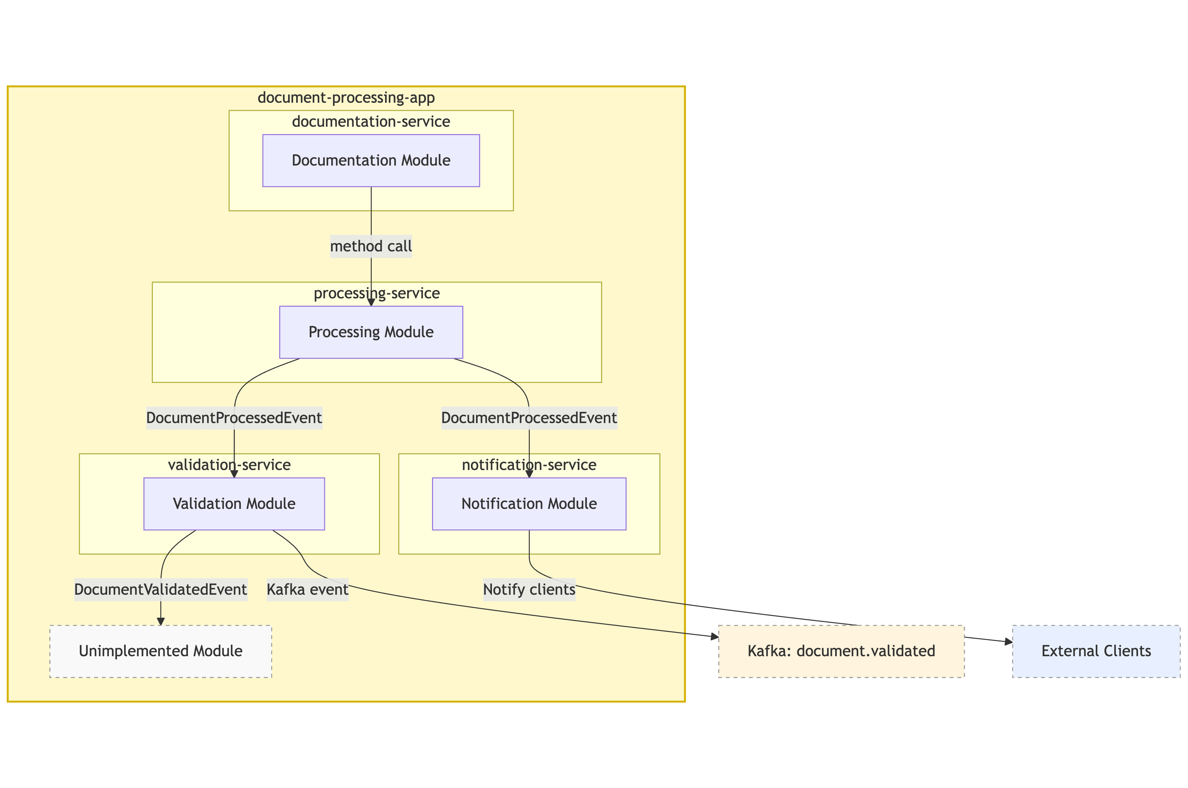
Async communication in modular monolith document-processing-app

Slide 5
Modular monolith vs microservices
Aspect | Modular Monolith | Microservices
Deployment | Single deployable unit | Independently deployable units
Dev Speed | Fast (monorepo, fewer barriers, easy debugging etc.) | Slower (infra & comm overhead)
Scalability | Scale whole app | Fine-grained, per-service scale
Ops Complexity | Low | High (infra, observability, etc)
Communication | In-process or async events | Network-based (REST, gRPC, etc)

Slide 6
Modular monolith: pros
Simplified Operations
Reduced Duplication
Faster Development
A single deployable artifact means one CI/CD pipeline and straightforward monitoring. Teams avoid managing multiple build/deploy processes, reducing operational overhead and easing maintenance for small to medium projects.
Shared libraries, configurations, and utilities live in one codebase. You eliminate repeated boilerplate and redundant dependencies, making development more efficient and promoting consistent standards across modules.
Developers work in one repository with immediate access to all modules. No need to spin up multiple services locally—code changes are easier to test and deploy, accelerating feature delivery.
Easier Future Split
Reuse of microservice practices
Well-defined modules and domain boundaries simplify later extraction into microservices. When the time comes to move to distributed systems, your clear modular structure acts as a blueprint for service boundaries.
Apply proven patterns — like clear DDD boundaries, async communication, interface-driven design, observability, and modular CI/CD — without needing distributed infrastructure.

Slide 7
Modular monolith: cons
Single Point of Failure
Limited Scalability
Risk of Spaghetti Code
All modules share the same runtime environment, so if one module crashes or misbehaves (e.g., memory leak, infinite loop), it can take down the entire application, affecting unrelated business functionality and overall system uptime.
Unlike microservices, you can’t scale individual modules independently. If one part of the app gets heavy traffic, you must scale the entire application, wasting resources and making fine-grained performance tuning difficult.
Without discipline and clear boundaries, module interdependencies can grow unchecked. Teams might shortcut proper design, creating tight coupling between modules that leads to a messy, entangled codebase — the classic “big ball of mud.”
This slide outlines some of the key limitations and challenges that teams may face when adopting this approach, especially as systems evolve and scale.

Slide 8
Why modular monolith is back
Microservice fatigue
Simpler dev & ops
Clean boundaries still possible
Teams face growing complexity with microservices: deployment overhead, boilerplate code, and communication issues. Many are realizing the trade-offs aren't always worth it, especially at smaller scales.
A single repo and deployment pipeline make development, testing, and debugging easier. Perfect for lean teams that need speed without managing a fleet of services and infrastructure.
Modern frameworks support strong internal separation. You can follow DDD, modularity, and clear domain ownership — without splitting code into fully independent services.
As microservices hit scaling and complexity limits, teams are rediscovering the power of modular monoliths — offering structure without the overhead of distributed systems.
Better for evolving domains
Microservices aren’t free
If your domain is still changing, a modular monolith keeps things flexible. It avoids premature service boundaries that are hard to undo later.
Latency, distributed tracing, orchestration, and eventual consistency all add cost. Many teams discover that microservices require significant effort and investment to do well.

Slide 9
When to choose a modular monolith
Fast iteration required
Small team, big scope
Domain still evolving
Perfect for early-stage projects where rapid changes are frequent. You avoid the deployment and coordination overhead of microservices while iterating quickly in one codebase.
Small dev teams benefit from shared context, less boilerplate, and simpler coordination — all without needing service-level ops, observability, or CI/CD complexity.
When business rules and boundaries are still in flux, modular monoliths let you keep things fluid internally while slowly discovering domain boundaries.
Modular monoliths offer a pragmatic starting point when speed, simplicity, and flexibility matter more than distributed scaling. Ideal for small teams, evolving domains, and early-stage systems.
You don’t need all criteria to apply — if 2–3 fit your case, it’s usually a strong choice.
Preparing for microservices
A well-structured modular monolith can become a clean stepping stone — allowing gradual migration to microservices without rewriting from a “big ball of mud.”

Slide 10
Asynchronous communication between modules
Decouples modules
Improves modular scalability
Enables observability & auditing
Asynchronous events eliminate the need for direct method calls, allowing modules to remain unaware of each other’s internal details while still collaborating effectively through shared domain events.
Time-consuming logic like validation or notifications can run in parallel, freeing up the caller and improving perceived performance without adding distributed system complexity.
Event-driven flows naturally support logging and tracing of what happened, when, and where — enabling better debugging, auditing, and even replay of workflows when needed.
Use events to decouple modules, improve scalability, and simulate microservice-style behaviour — all within a single deployable unit.
Prepares for microservices
Tech examples
By designing modules around asynchronous communication now, you make it easier to break them into true services later, with minimal refactoring or behavioural changes.
Frameworks like Spring make this simple with @Async, domain event publishers, or even lightweight Kafka integration — all usable inside a single application context.

Slide 11
Demo highlights
This live demo shows how a modular monolith can use clean internal APIs and async communication to coordinate domain logic — all within one deployable unit, yet ready for future scaling.

Slide 12
Thank you.
Romulus – Marius, Cimpeanu
Manager, Deloitte Tehnologie
Contact: rcimpeanu@deloitte.com

